Slide 1
Digital Development
Building a solution

Slide 2
Agenda

Slide 3
Integrated Development Environment (IDE)
Code Editor
Simple Debugging Tools
Compiler
Error Diagnostics
Run-time Environment (Console)
Graphical User Interface

Slide 4
Programming Language Features
Data Types - Strings, Ints, DateTime, etc.
Control Structures - If, If Else, Loops (While, For)
Functions - Built In, User Defined
Data Structures - Arrays
String Handling - Concatenation
Logical and Relational Operators (AND, <=, >=)

Slide 5
software

Slide 6
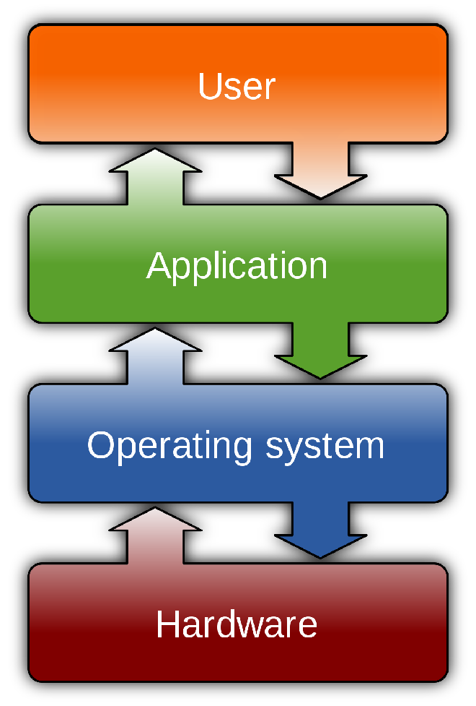
what is a software application
Instagram, Snapchat, Microsoft Word, Internet Explorer are all Software Applications that execute on Computer Hardware
The application runs on top of an Operating System (Windows, OSX, Android, iOS) which simplifies how the Application interacts with the underlying Hardware for e.g. how Instagram interacts with a mobile phones camera
Notes:
Application software (app for short) is software designed to perform a group of coordinated functions, tasks, or activities for the benefit of the user. This contrasts with system software, which is mainly involved with running the computer.

Slide 7
what is an application
Computers work by giving (Programming) them instructions for things you want them to do
Different Applications give different instructions
When an Application is started, a specific set of instructions are executed by the Computer
The process of creating an Application is about producing the instructions (Software) that you want the Computer to execute
Notes:
Application software, or simply software, is a collection of data or computer instructions that tell the computer how to work. The instructions are created (Programmed) by an Engineer (Developer/Programmer)

Slide 8
how to create software
Computer accept instructions using 0's and 1's, Humans create instructions using words (speech or written)
We need a way for Humans to create instructions (a Language) and for them to be translated (Compiled) into something Computers understand (the Application)
Notes:
A Programming Language is a vocabulary and set of grammatical rules for instructing a computer or computing device to perform specific tasks.

Slide 9
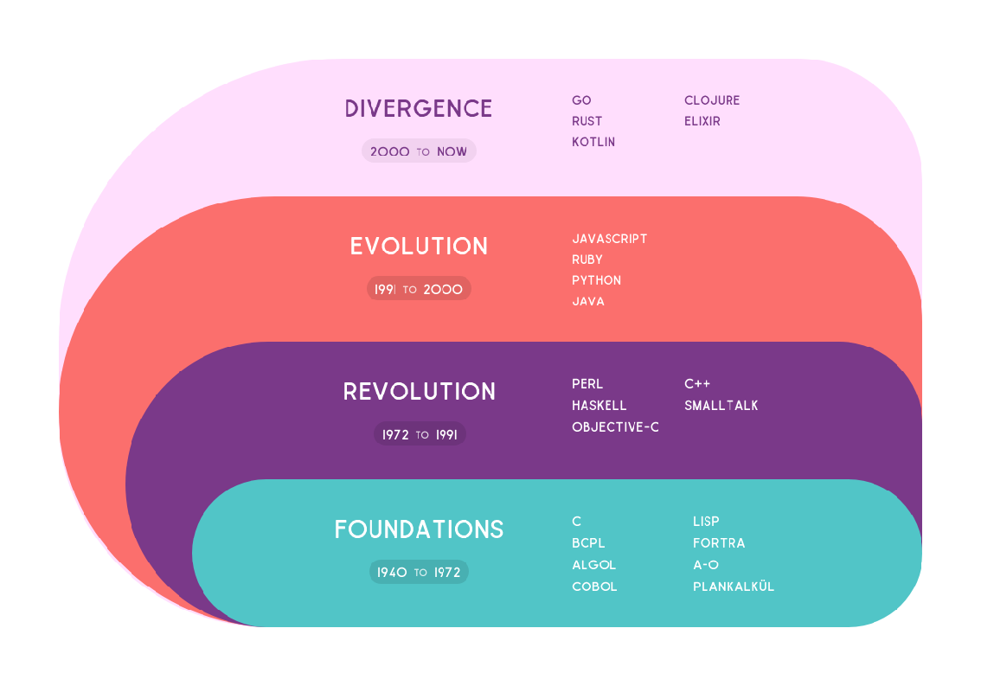
what is a programming language
A way for Humans to program instructions onto a Computer to tell it to do a specific task e.g. post a tweet
There are a lot of different languages to choose from (see notes)
Different Languages can be used to program the same instructions, in the same way that you can tell someone in English or French to 'close the door'
Notes:
Programming languages are tools, and we choose different tools for different jobs. A tractor trailer and a bicycle and a Tesla are all vehicles – they have wheels and steering and will get you from point A to point B – but obviously we use them for different things.
Programming languages are similar. Ruby and JavaScript are great for building web sites; Java and C++ are often used for financial trading; Python and R are the tools of choice for analyzing statistics.

Slide 10
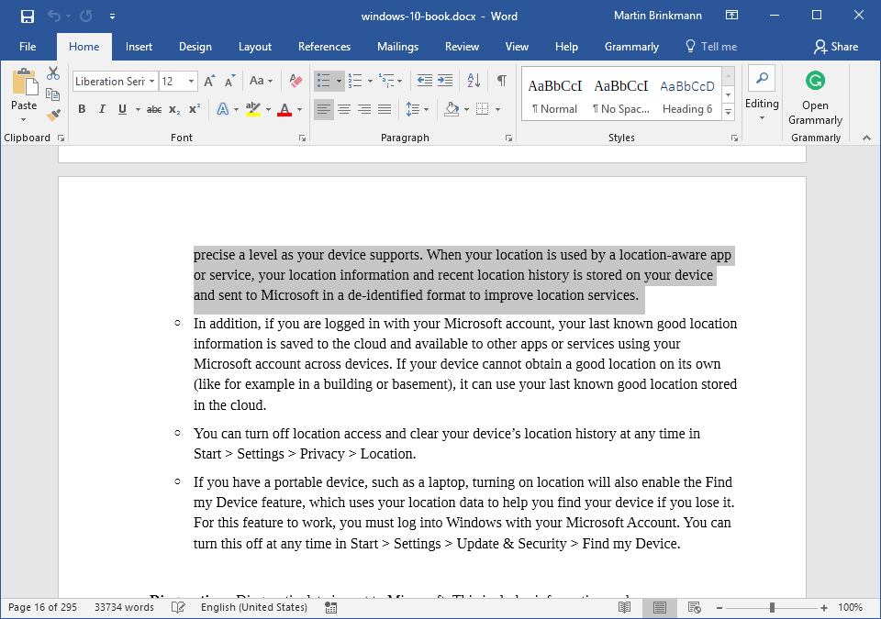
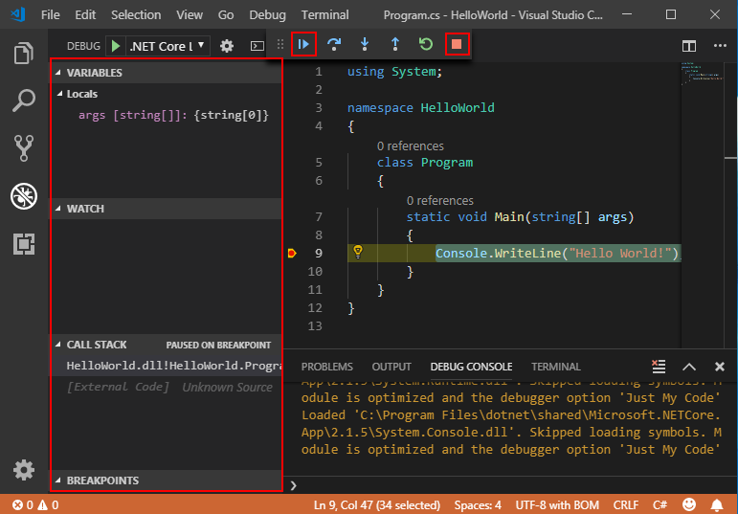
tools to make it easier
Working with a Programming Language is like working with English
We have tools to make it easier
We use Microsoft Word when writing an Essay
We use a Integrated Development Environment (IDE) when writing Application Software
Notes:
In the same way there are lots of different document editors; Microsoft Word, Google Docs, OpenOffice, Pages, etc. There are lots of different IDE's. Each IDE offers more or less the same features, with some being specifically adapted for a particular Programming Language.

Slide 11
integrated development environment
Virtually every IDE will have a text editor designed to write and manipulate source code.
Some tools may have visual components to drag and drop front-end components, but most have a simple interface with language-specific syntax highlighting.
Notes:
The syntax of a Programming language is the set of rules that defines the combinations of symbols that are considered to be a correctly structured document or fragment in that language

Slide 12
Compilation
A Compiler is a application that translates instructions written in a Programming Language (source language) into another Programming Language (target language).
The name Compiler is primarily used for programs that translate source code from a high-level programming language (C#) to a lower level language (machine code) to create an executable program (Application).
Notes:
A compiler is a special program that processes statements written in a particular programming language and turns them into machine language or "code" that a computer's processor uses to execute instructions.

Slide 13
Debugger
Debugging tools assist users in identifying and remedying errors within source code.
They often simulate real-world scenarios to test functionality and performance.
Programmers and software engineers can usually test the various segments of code and identify errors before the application is released.

Slide 14
application

Slide 15
Getting started - Tools
IDE - https://code.visualstudio.com
IDE Extension for C# - https://marketplace.visualstudio.com/items?itemName=ms-vscode.csharp
C# Software Development Kit (SDK) - https://dotnet.microsoft.com/learn/dotnet/hello-world-tutorial/install
Notes:
The features that Visual Studio Code includes out-of-the-box are just the start. VS Code extensions let you add languages, debuggers, and tools to your installation to support your development workflow.

Slide 16
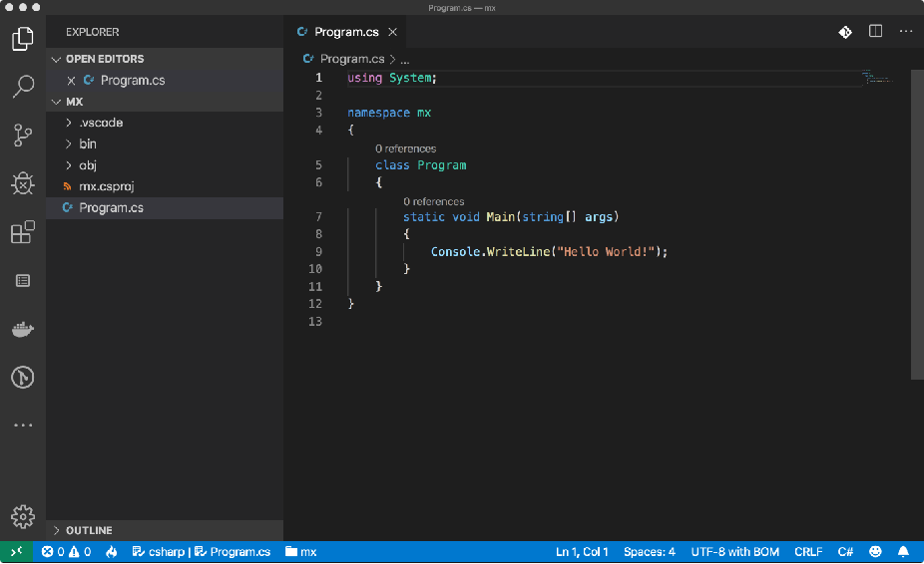
vscode
Visual Studio Code is a source-code editor developed by Microsoft for Windows, Linux and macOS.
It includes support for debugging, syntax highlighting, intelligent code completion, snippets, and code refactoring.
Additional functionality can be added to it through extension plugins
It is a simpler IDE for C# development than Visual Studio IDE

Slide 17
.NET SDK
.NET Core Software Development Kit (SDK) is a set of libraries and tools that allow developers to create .NET Core applications and libraries. It contains the following components that are used to build and run applications:
The .NET Core CLI tools.
.NET Core libraries and runtime.
The dotnet driver.

Slide 18
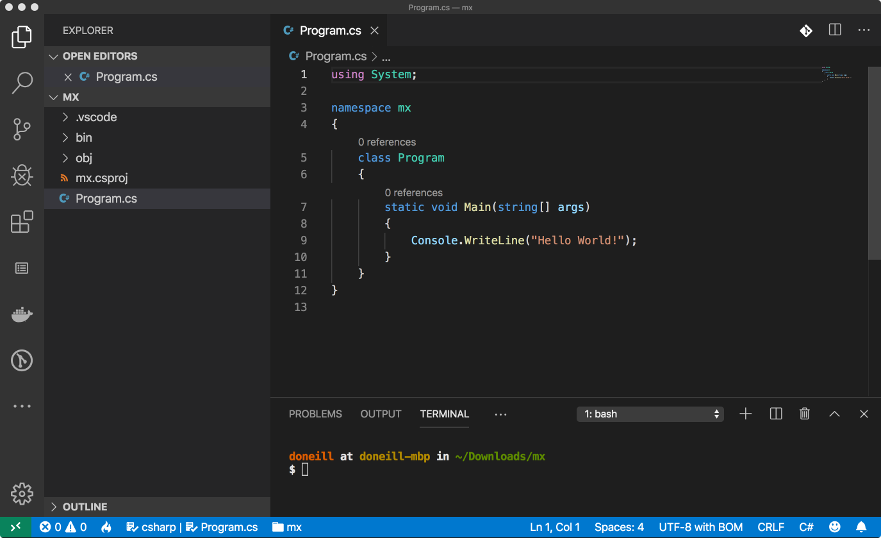
File Editor
File List
Terminal
Notes:
File List - shows the Explorer view which shows files that are available within the current vscode instance
File editor - shows the file currently open for editing
Terminal - provides a command line terminal for running commands on the operating system

Slide 19
Hello world
Use the .NET SDK to create a skeleton cli application
.NET SDK includes an CLI Application called 'dotnet', we will use this to 'scaffold' the files needed for the application.
We will run the dotnet CLI command from within vscode using the terminal window
Notes:
A "Hello, World!" program generally is a computer program that outputs or displays the message "Hello, World!". Such a program is very simple in most programming languages, and is often used to illustrate the basic syntax of a programming language. It is often the first program written by people learning to code.

Slide 20
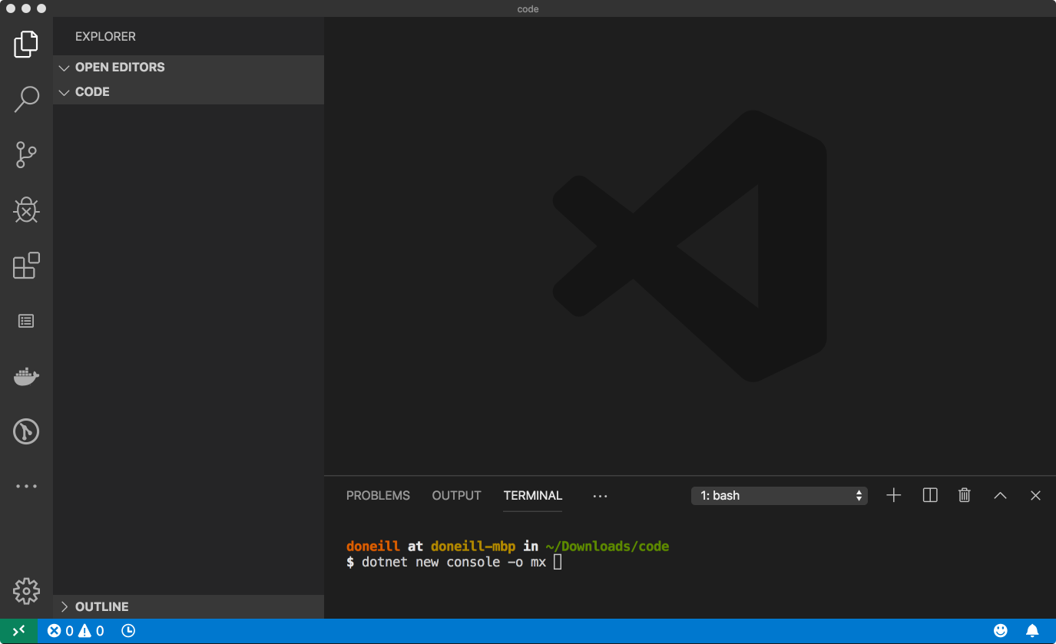
dotnet new console -o mx
Notes:
If you don't see the terminal window, it can be enabled by selecting View -> Terminal from the vscode main window.

Slide 21
Hello world
This will create a variety of files in the Explorer window, including a file called Program.cs
Program.cs contains the C# source code for our command line application
The structure of this source file is described on the next screen
Notes:
https://github.com/damianoneill/mx/tree/0001-Hello-World

Slide 22
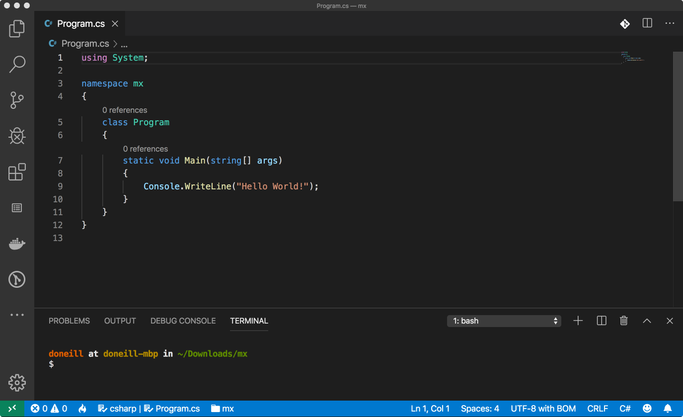
Import types
Organise classes
Custom type
Application
Entry Point
Notes:
A class enables you to create your own custom types by grouping together variables of other types, methods and events. In C#, a class can be defined by using the class keyword.

Slide 23
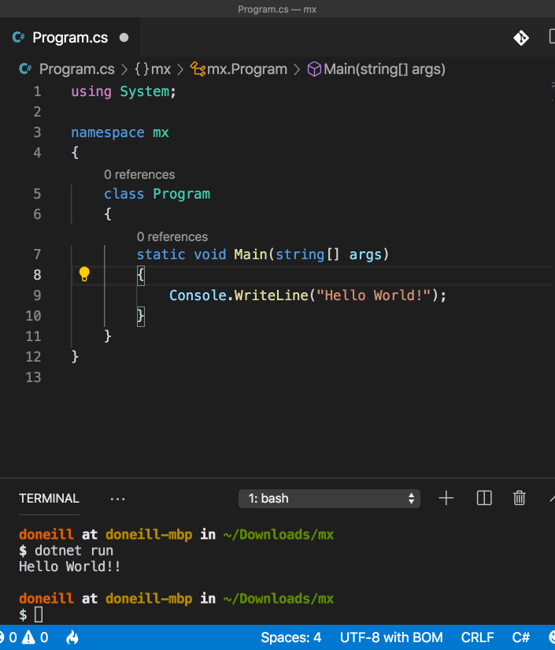
Running the Application
We can run the application by typing dotnet run in the Terminal Window
This will Compile (translate) the source code to a executable and run the application outputting the text 'Hello World!' to the terminal
The application uses the Class Console and the Method WriteLine to output this text
Notes:
Classes and Methods will be covered later in the deck.

Slide 24
Data Types in C#
numeric
int (4 bytes), -2147483648 to 2147483647
character
char (2 bytes), 0 to 128, examples; a,b,4
string
string (20+ bytes), examples; "Hello World"
boolean
bool (1 byte), false or true
date/time
DateTime (8 bytes), 00:00:00 01/01/0001 to 23:59:59 31/12/9999, examples; 14:28:32 08/05/2019
Notes:
Full list of data types for C# available here https://www.tutorialsteacher.com/csharp/csharp-data-types

Slide 25
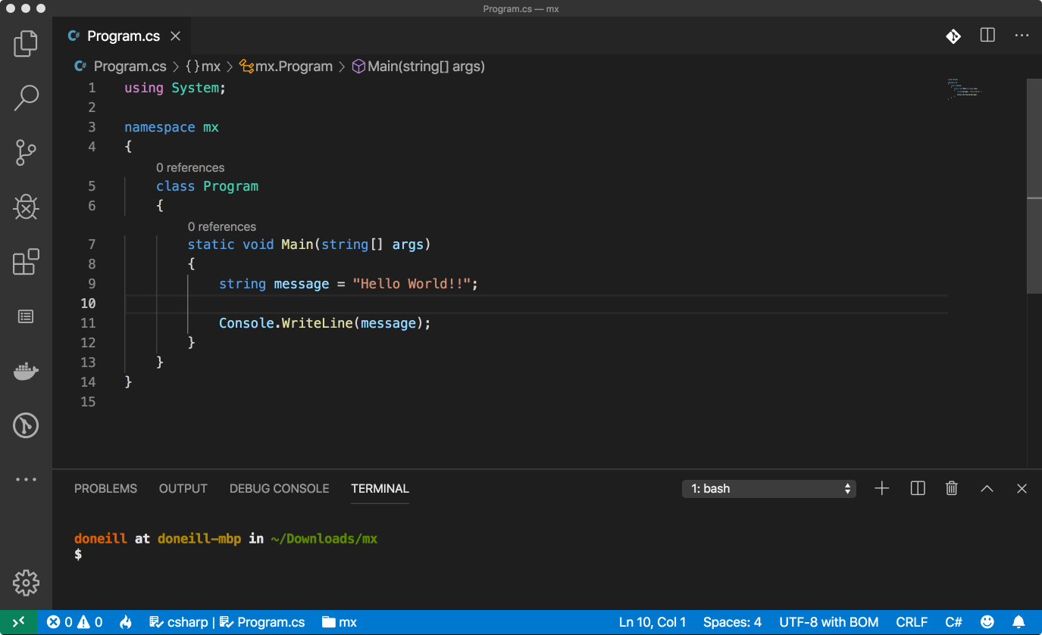
Notes:
We've created a Data type of string and gave it a name called message, and used it in the method Console.Writeline

Slide 26
Collect some input
Now that we can write output to the Terminal, lets collect some input.
If Console.WriteLine writes output to the Console (Terminal) then ...
Console.Readline Reads input from the Terminal

Slide 27
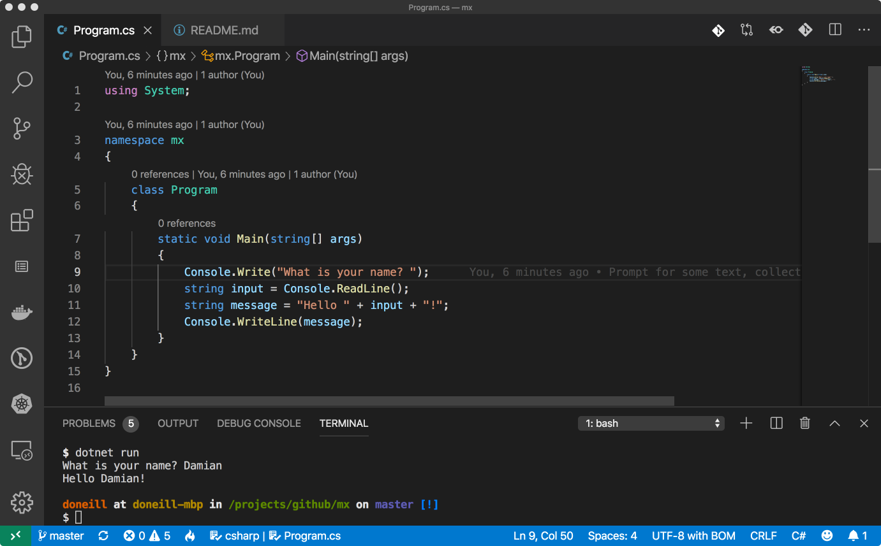
Notes:
In the Main Method we Prompt the user for their name, collect this from the Console, append it to a greeting string and write it out to the Console
https://github.com/damianoneill/mx/tree/0002-Input

Slide 28
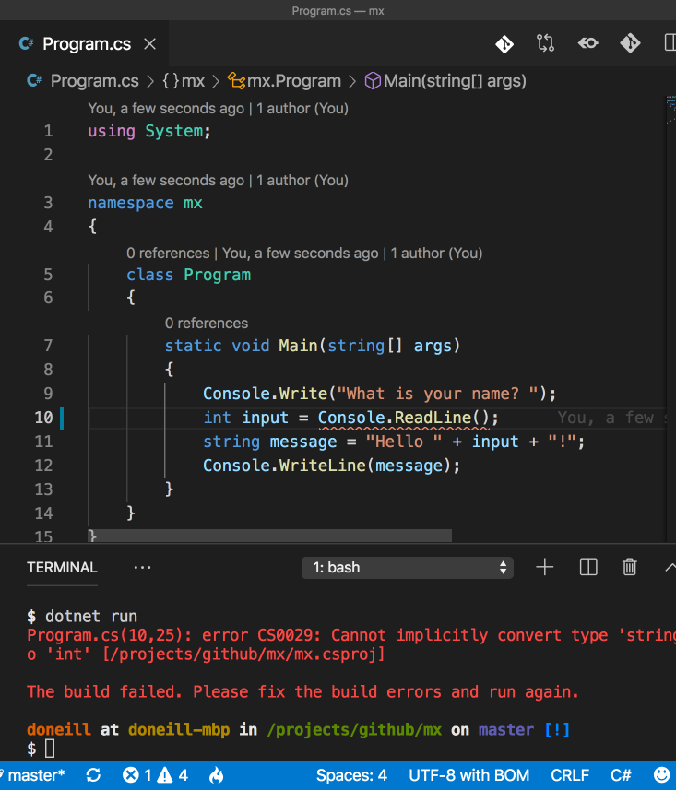
Mix and matching data types
What happens if we change the input type to be an int instead of string?
Syntax highlighting in the IDE recognises there is a problem (red underline)
Compiler complains that the method returns a string but try's to set the value to an int (not allowed)

Slide 29
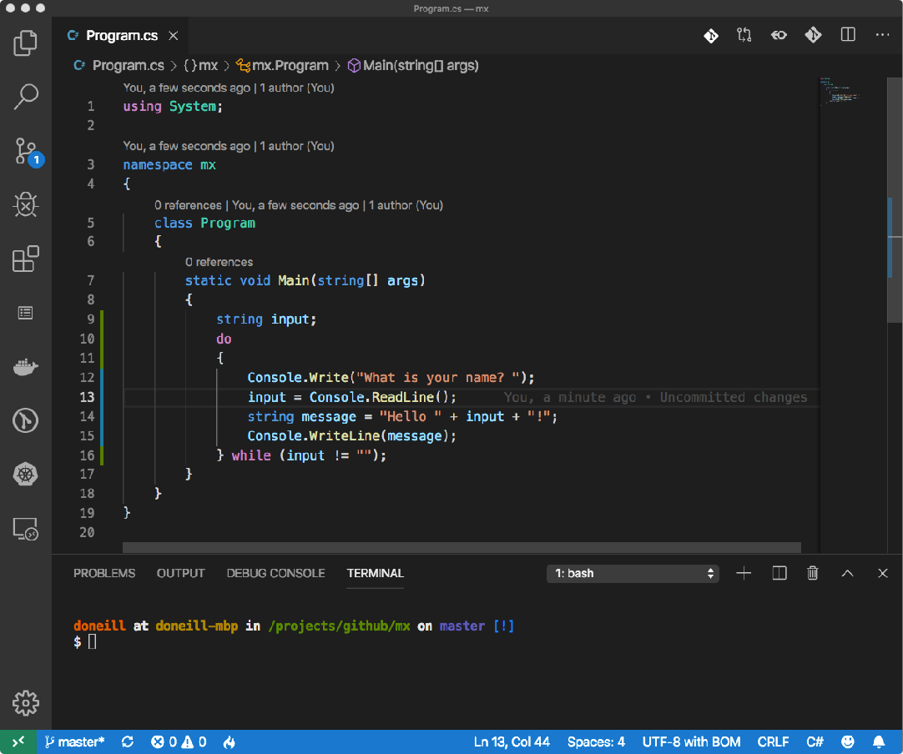
Again and Again and again
Lots of times computers programs do the same thing over and over, this is called a Loop
There are different ways of creating a loop in code
One way is to do something while a condition is met (or not met)
In the shown example the condition is that input is not empty
Notes:
There are different ways of doing loops, common examples include using keywords while, do / while, for and foreach. A good overview for csharp based loops is available here https://www.tutorialspoint.com/csharp/csharp_loops

Slide 30
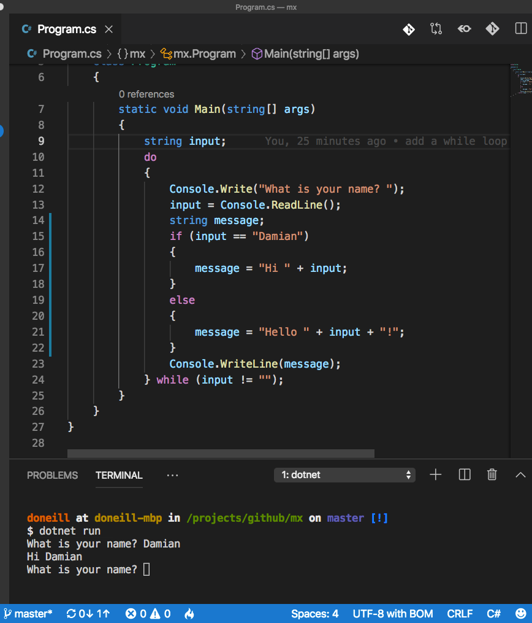
Decision making
Software Applications make decisions all the time
For e.g. in a Driving Application turn left or turn right, if the User a Child or Adult
A common way of handling a decision is if a condition is valid (true) then do one thing else do another thing
Notes:
https://github.com/damianoneill/mx/tree/0003-loops-conditionals

Slide 31
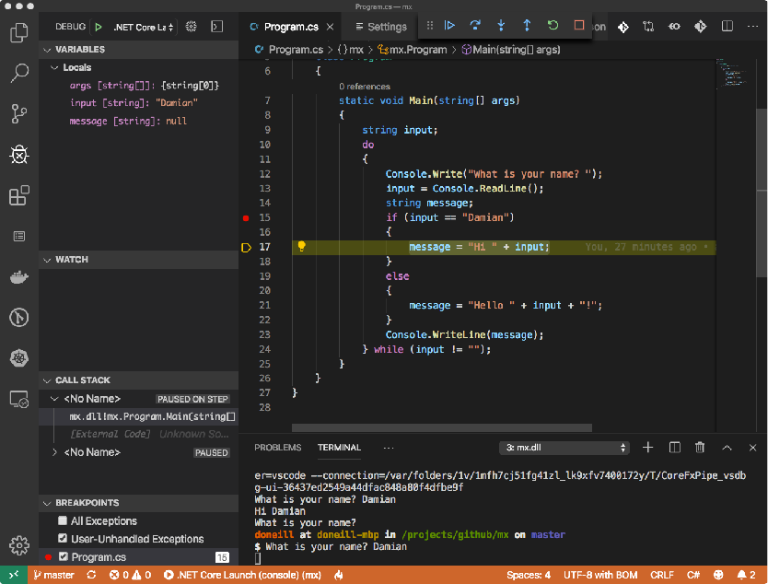
Debugger
When you debug your app, it usually means that you are running your application with the debugger attached.
When you do this, the debugger provides many ways to see what your code is doing while it runs.
You can step through your code and look at the values stored in variables, you can set watches on variables to see when values change, you can examine the execution path of your code, et al.
Variables and
current values
Condition is true

Slide 32
day two

Slide 33
Sample Application
The sample application will be command line based (no Graphical component)
Query a Database, using a Web Service
Build a set of features around the returned data
Notes:
Command Line Applications (aka CLI applications or simply CLIs - for Command Line Interface) are programs that you interact with entirely through your terminal and shell. They have no graphics or visual interface beyond what you see in your terminal after you run the program.

Slide 34
Web apis
Application Programming Interface (API) is some kind of interface which has a set of functions that allow programmers to access specific features or data of an application, operating system or other services.
Web API as the name suggests, is an API over the web which can be accessed using HTTP protocol.
https://github.com/public-apis/public-apis - list of public apis that can be used
https://promotocrossapi.com/docs - sample web api that we will use for this application

Slide 35
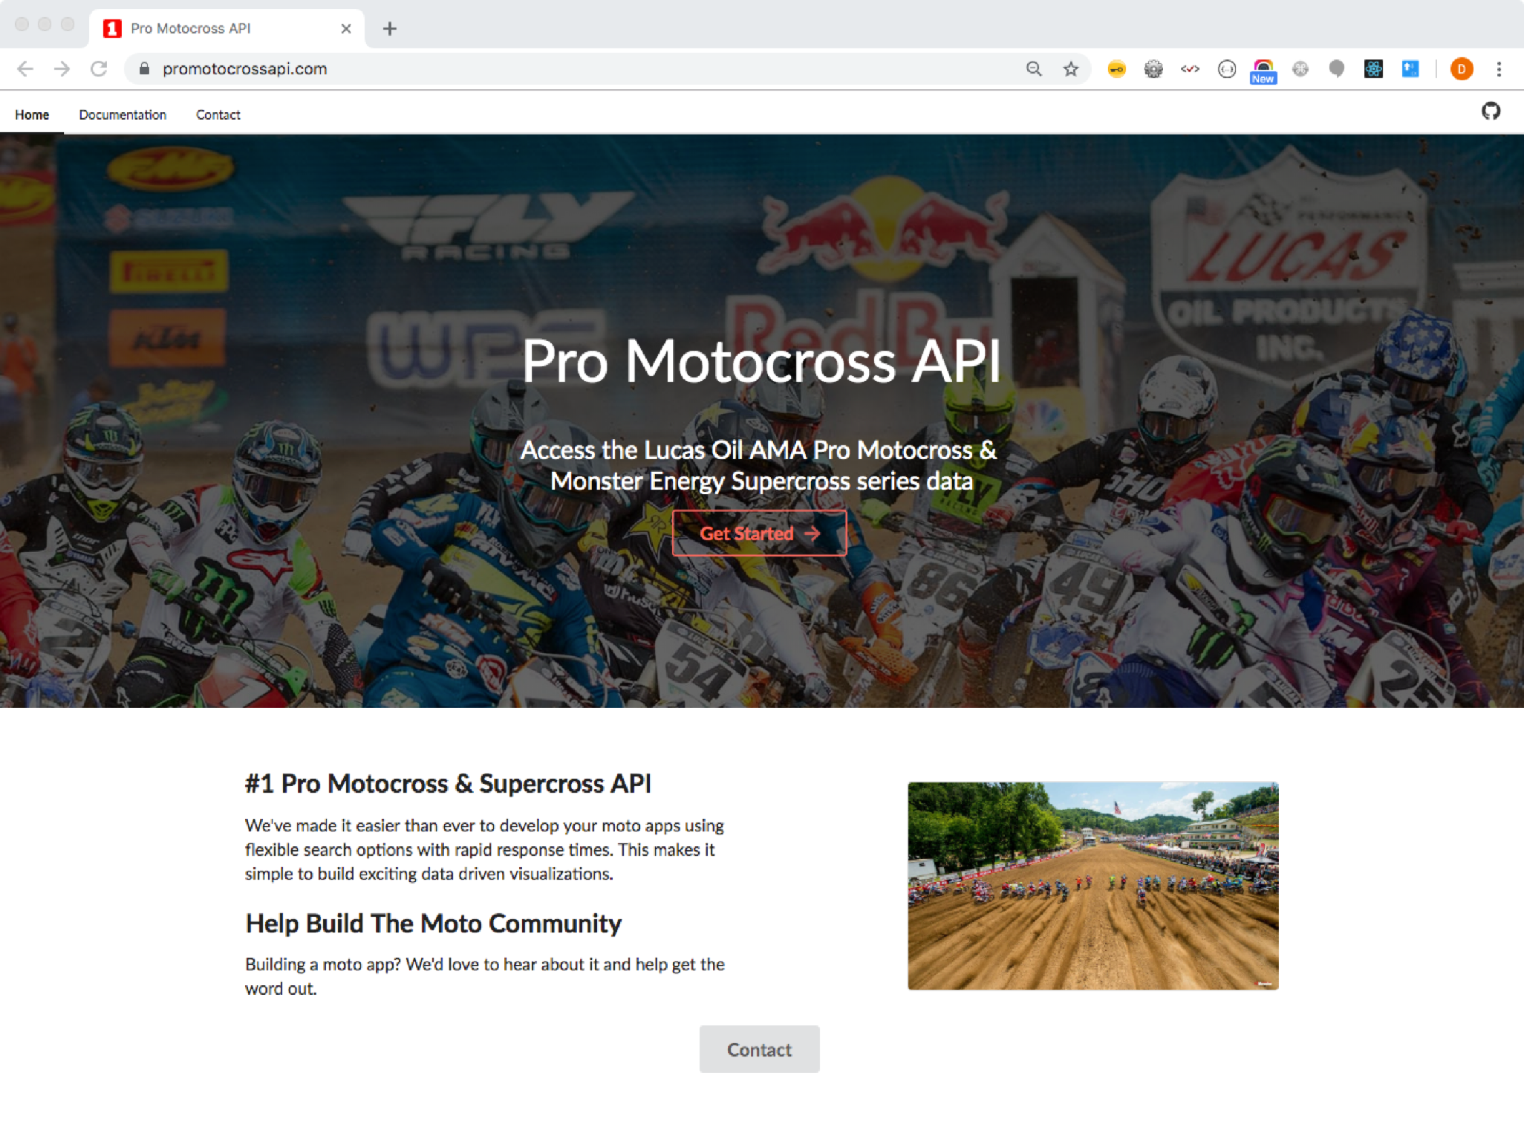

Slide 36
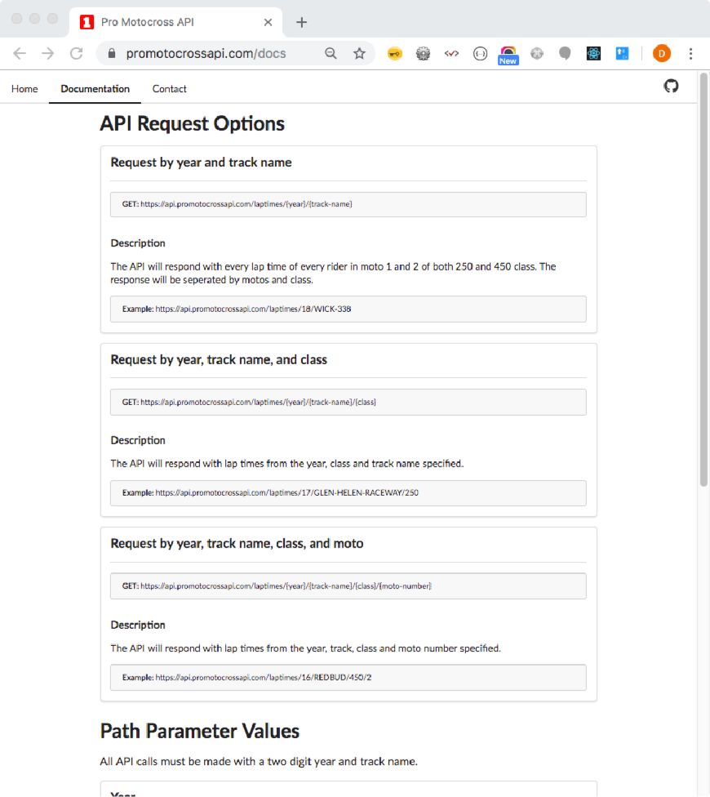
Sample web service
Pro Motocross website includes documents on what Requests can be made and how
For example calling https://api.promotocrossapi.com/laptimes/18/WICK-338 will return a dataset from 2018 for all the races at the WICK-338 track.

Slide 37
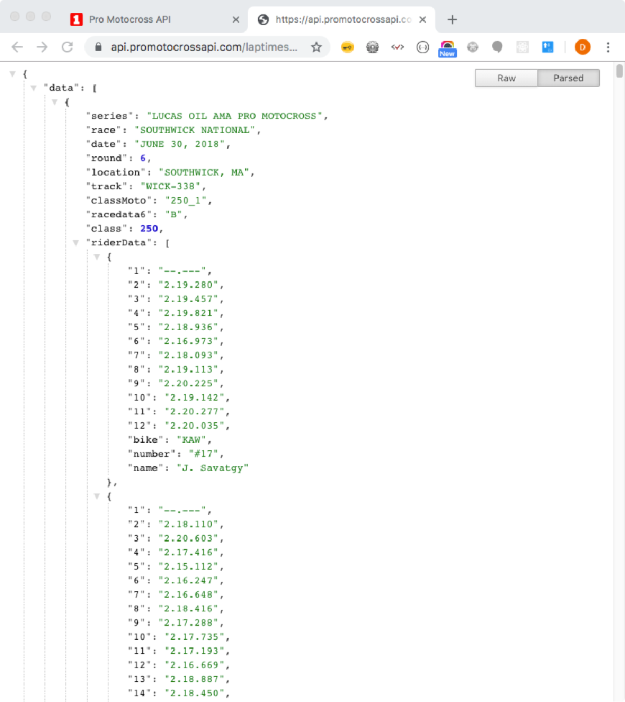
database query results
Click https://api.promotocrossapi.com/laptimes/18/WICK-338 in browser
Screenshot shows a subset of the data that was returned
Returned information is in JSON format
We will need a library later to make working with JSON easier
Notes:
JSON stands for JavaScript Object Notation
JSON is a lightweight format for storing and transporting data
JSON is often used when data is sent from a server to a web page
Our sample application will work like a browser and send a request to the server

Slide 38
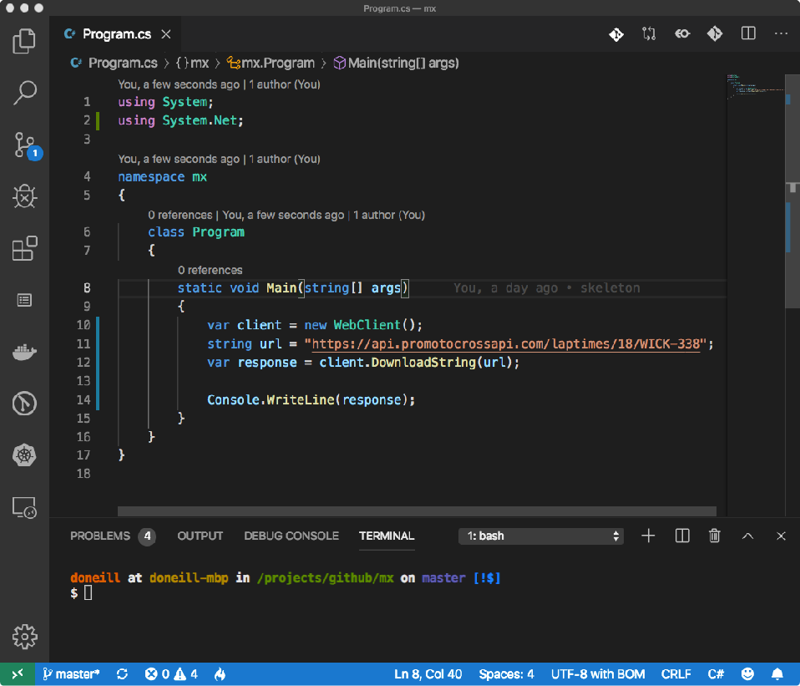
Sample database request
Use a Class (WebClient) from Library system.Net to request the data
Store the data in a string type called response
Write the value of response to the Console

Slide 39
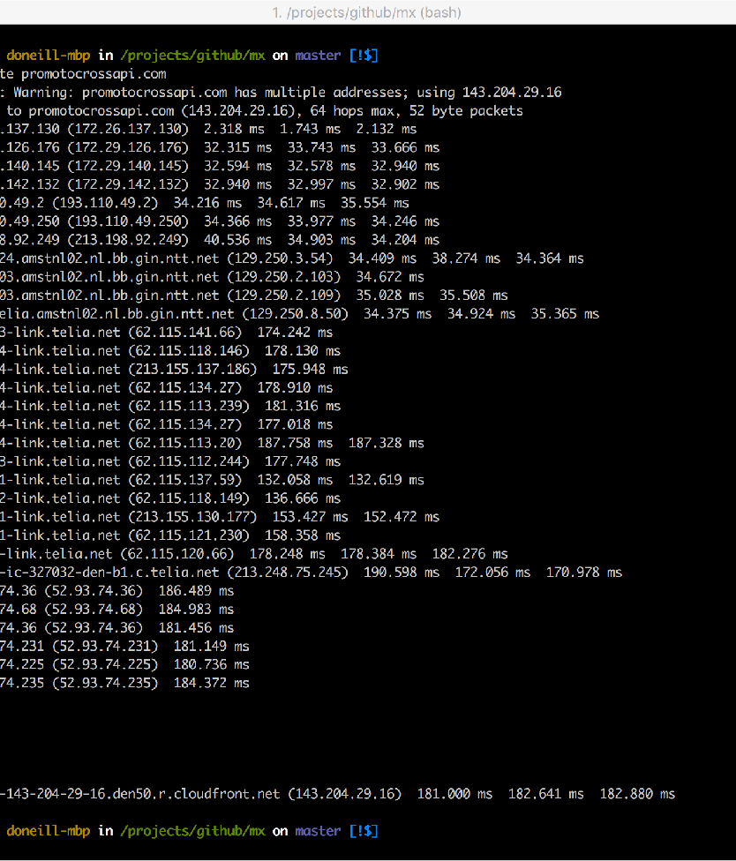
where is the data coming from
The website is hosted at 143.204.29.16
We can find where this is at by using a geo lookup http://geoiplookup.net/ip/143.204.29.16
This Database is running in Seattle, USA
We can see the route to request went to get there by running a traceroute
Notes:
All of the IP's that are shown on the screen are routers, these devices route the request across the internet from Belfast to Seattle, this route looks like the traffic went from Belfast to Seattle via Amsterdam.

Slide 40
Handle json data
We can use a tool to make it easy to work with the JSON data in C#
https://app.quicktype.io - insert JSON and the web page will create an autogenerated type for working with the JSON

Slide 41
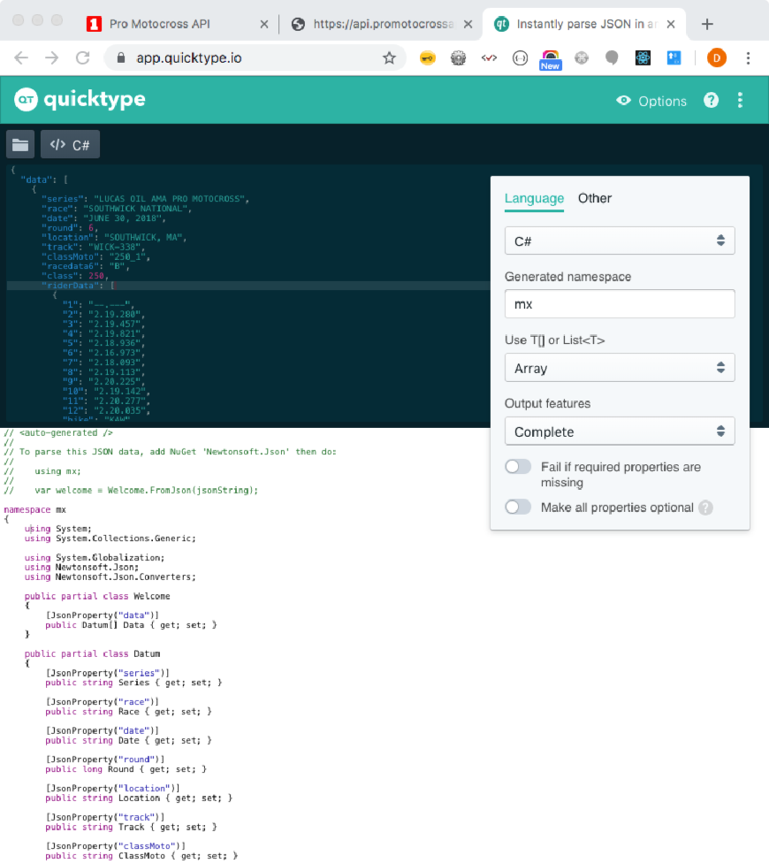
generate data type
Copy the JSON data into the box on the left
Select the language C#
Name the Namespace mx
Code is generated on the bottom of the screen
Save this in a file named Welcome.cs in the same directory as Program.cs

Slide 42
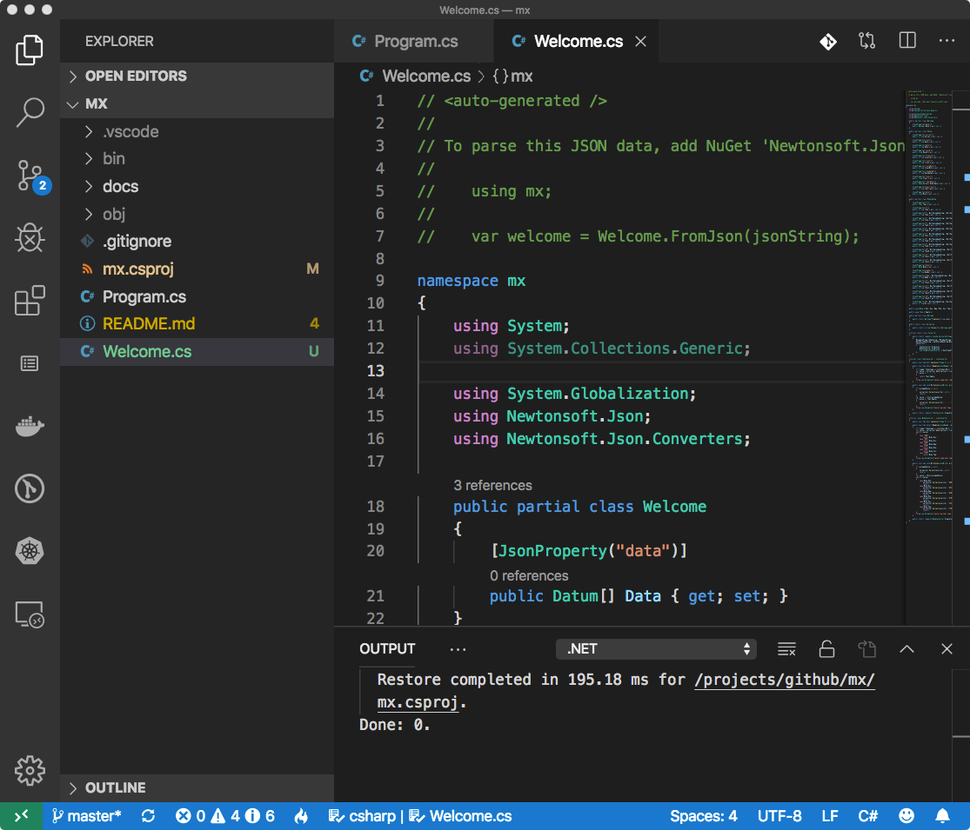
Notes:
Note the new file Welcome.cs, after its saved, the library that it uses Newtonsoft.json needs included in the project. Nuget extension (jmrog.vscode-nuget-package-manager) is used handle this in vscode.

Slide 43
using the new type
The mainline can now be updated to handle the JSON data returned from the Database using the autogenerated data type
This will make using the data much easier

Slide 44
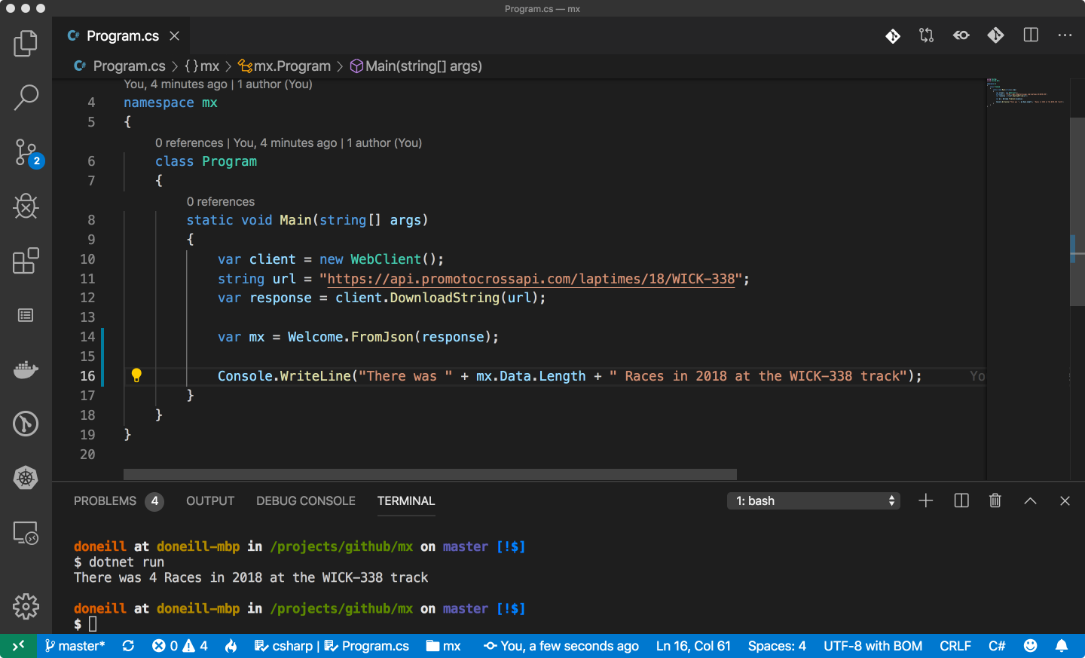

Slide 45
Making a second request
We can now call the Web Request again and change the query we send to the database
We can choose a different track and different year
The existing query will run, then the second query

Slide 46
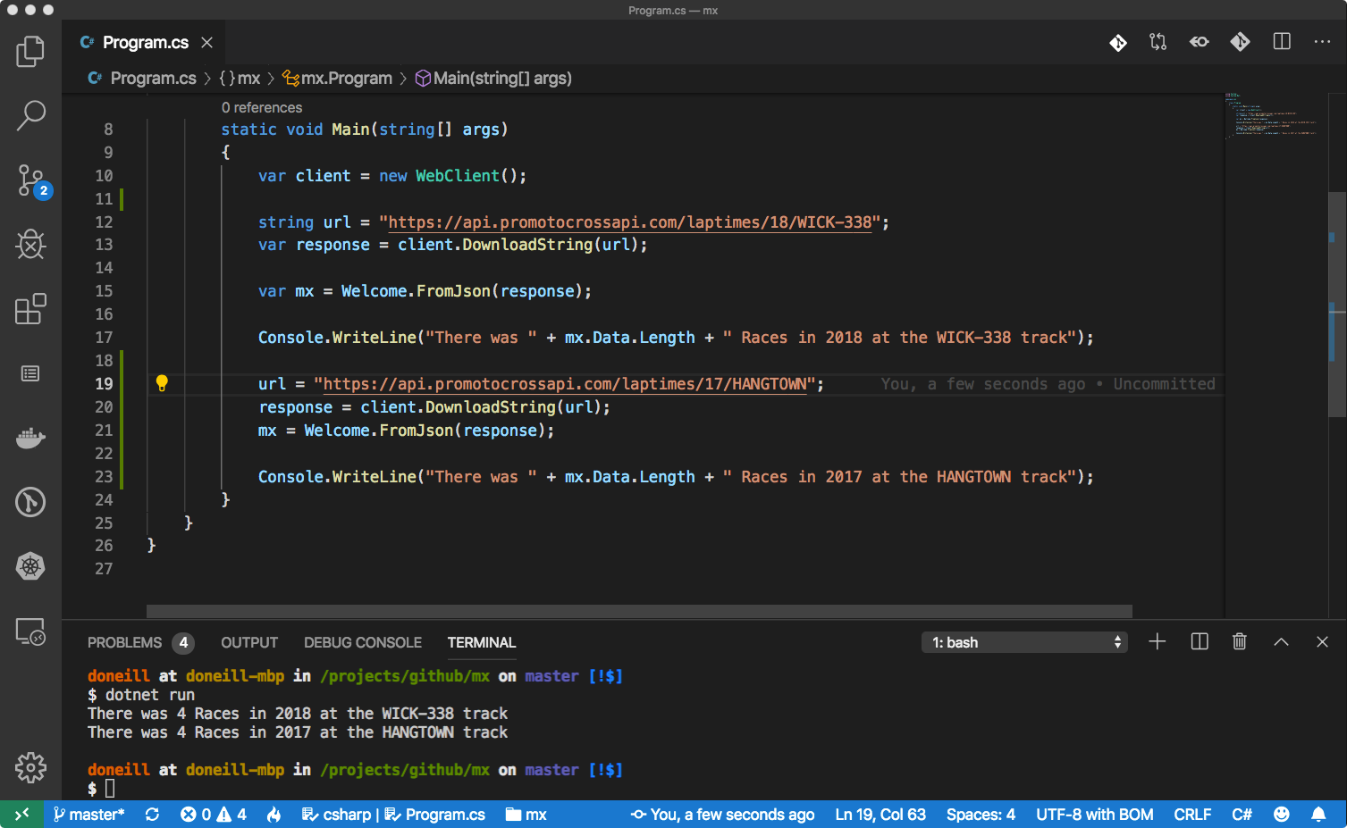

Slide 47
let the user choose
We'll introduce a Menu Function where the user can choose which request to make
A Console Menu is like a food Menu, you get a set of choices and you choose the one you want

Slide 48
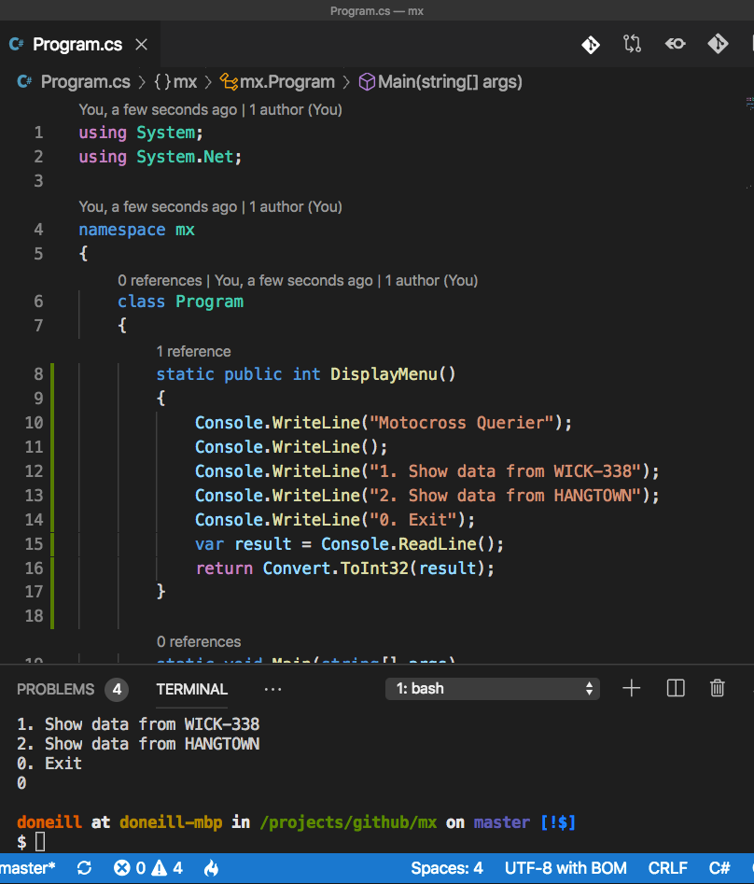
Menu function
Create a User Defined Function for displaying a Menu of options
The User Function writes a Menu to the Console
And reads a choice from the Console

Slide 49
Update the mainline to use the menu
Create a Loop that calls the User function to Display the Menu
In the Loop, based on the User Input, make a decision about what Request to send
Exit the Loop when the condition is met

Slide 50
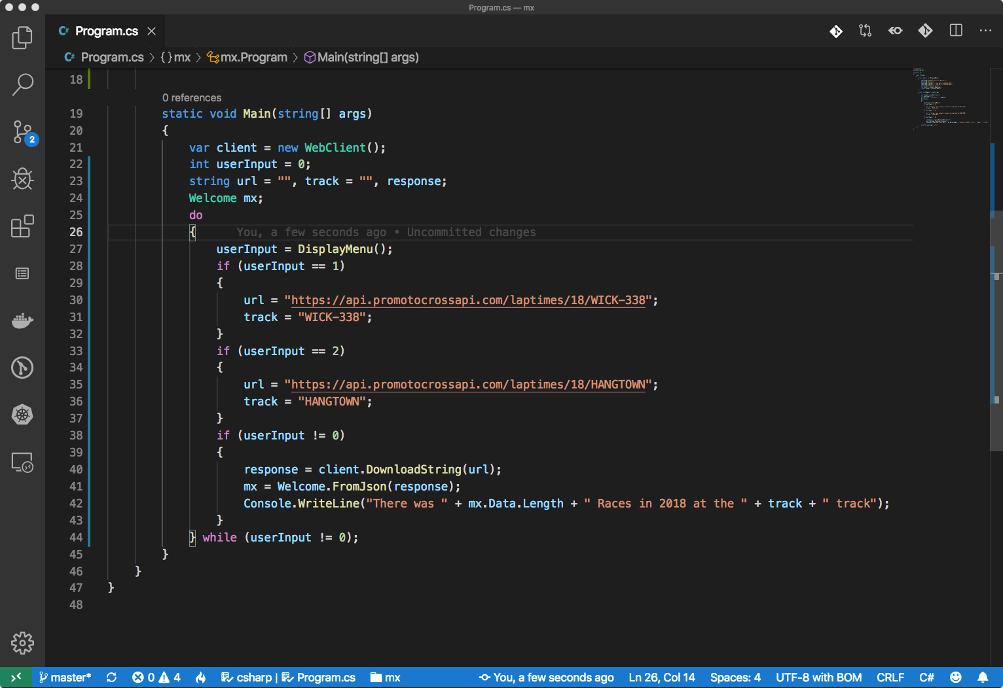
Loop
Decision
Loop
Exit
Condition

Slide 51
day three

Slide 52
Fixed loops
Some Loops run a fixed number of times, for e.g. a Loop that runs 7 times to simulate the days in a week
For these types of loops we use the for keyword
for (variable initialisation; condition; steps)
{
//execute this code block as long as condition is satisfied
}

Slide 53
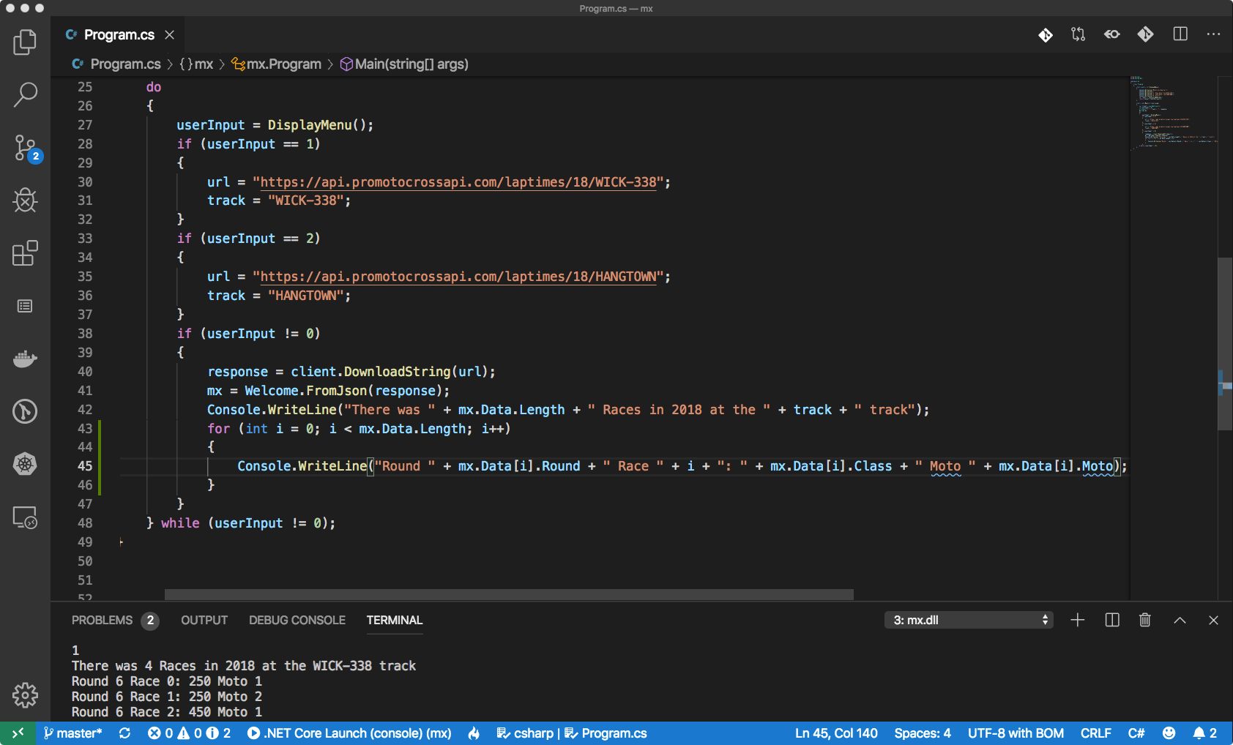

Slide 54
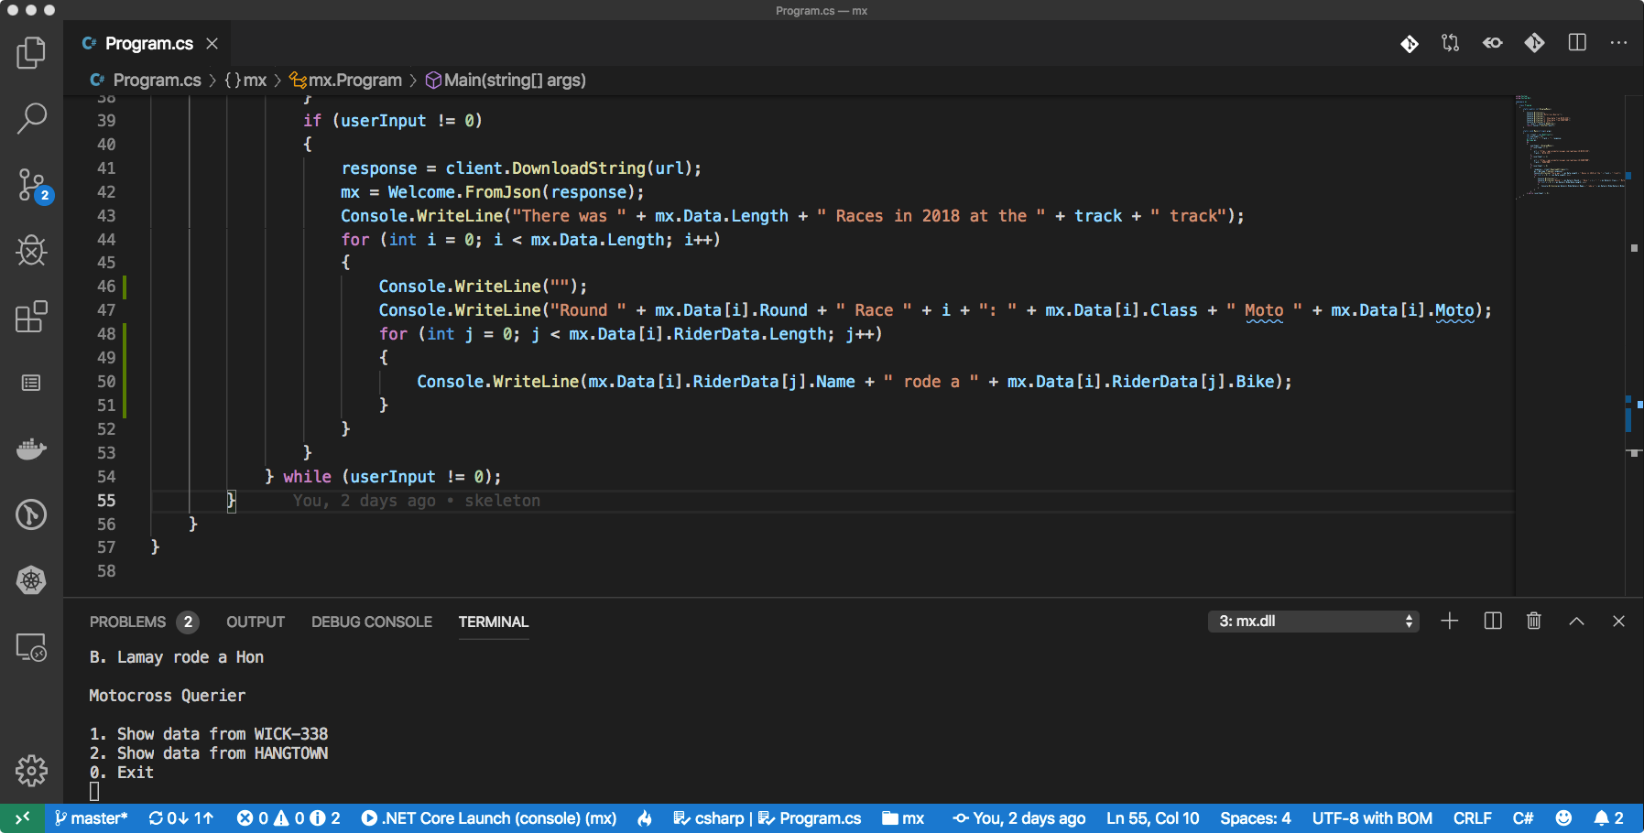
Loops within loops
Notes:
Note the use of j as an variable instead of i

Slide 55
validation (PLTFR)
Presence - e.g. Not Blank, File exists, etc.
Length - e.g. 10 Digits Long
Type - e.g. is a Number
Format - e.g. Specific Format (dd/mm/yyyy)
Range - e.g. a value between 10-20

Slide 56
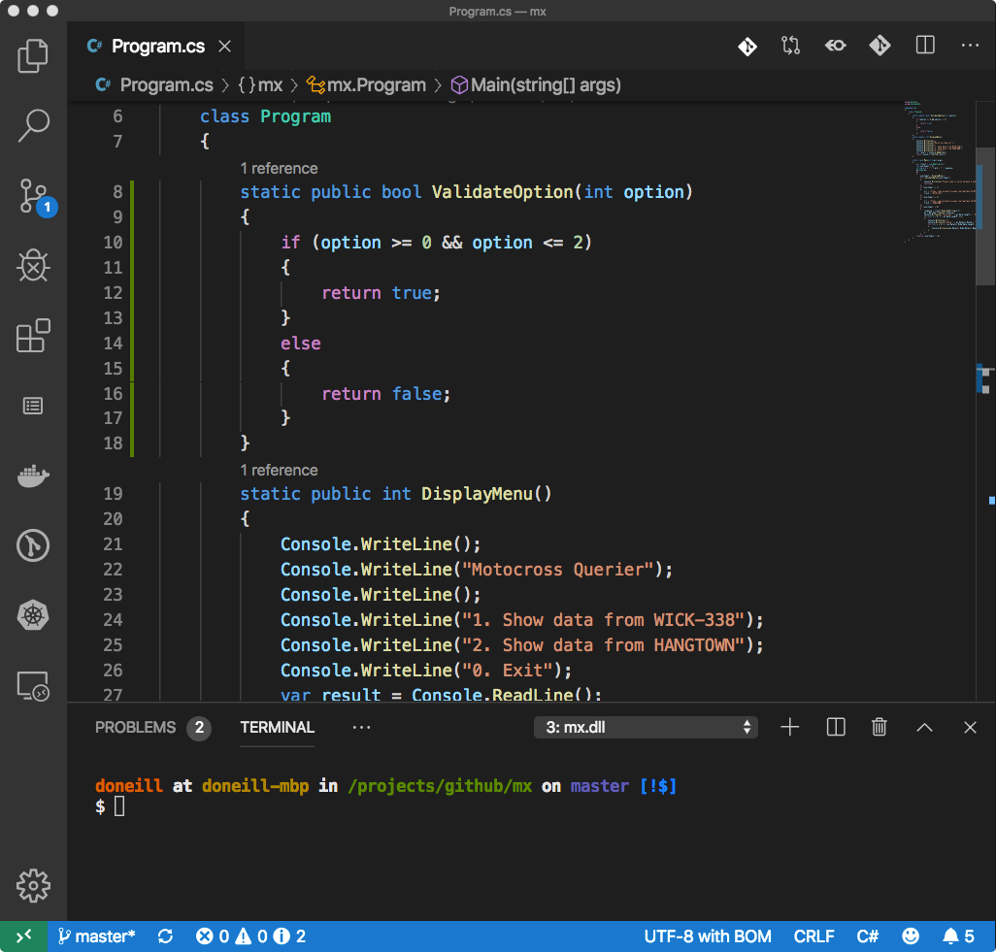
validate input
Lets add some code to validate our Menu's input
Create a User Defined Function for checking the value input by the User
Implement a Range Check with a Logical Operator AND (&&)
Use the Relational Operators Greater Than or Equal To (>=) and Less Than or Equal To (<=)

Slide 57
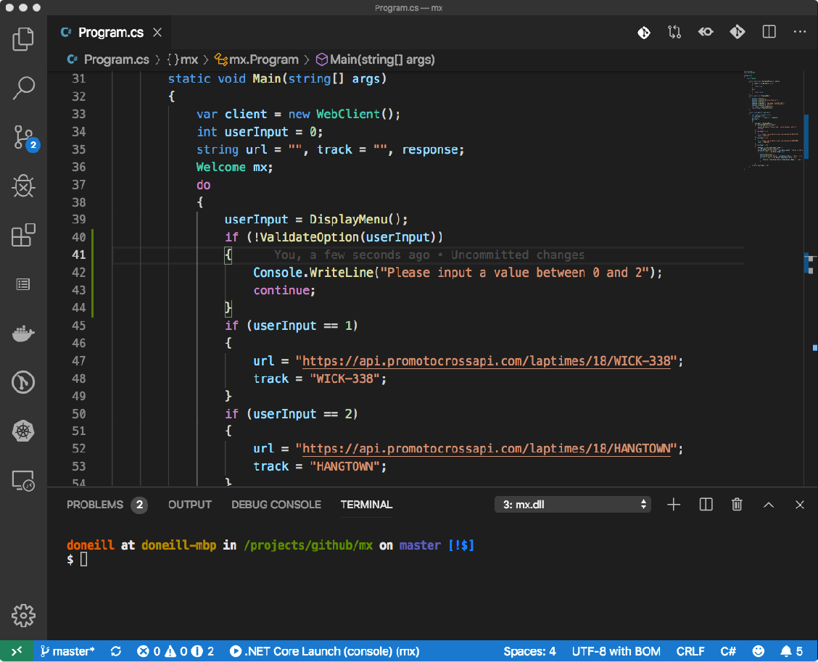
check input
Now update our loop to check the input every time the User make a choice
If the check fails, output a warning to the User
Exit this iteration of the Loop since the input is valid

Slide 58
writing to file
Check if a file (at a specific path) exists, if not notify the Users - Presence Check (Validation)
Open a File for Appending
Write a Line of text to the file including a DateTime data type

Slide 59
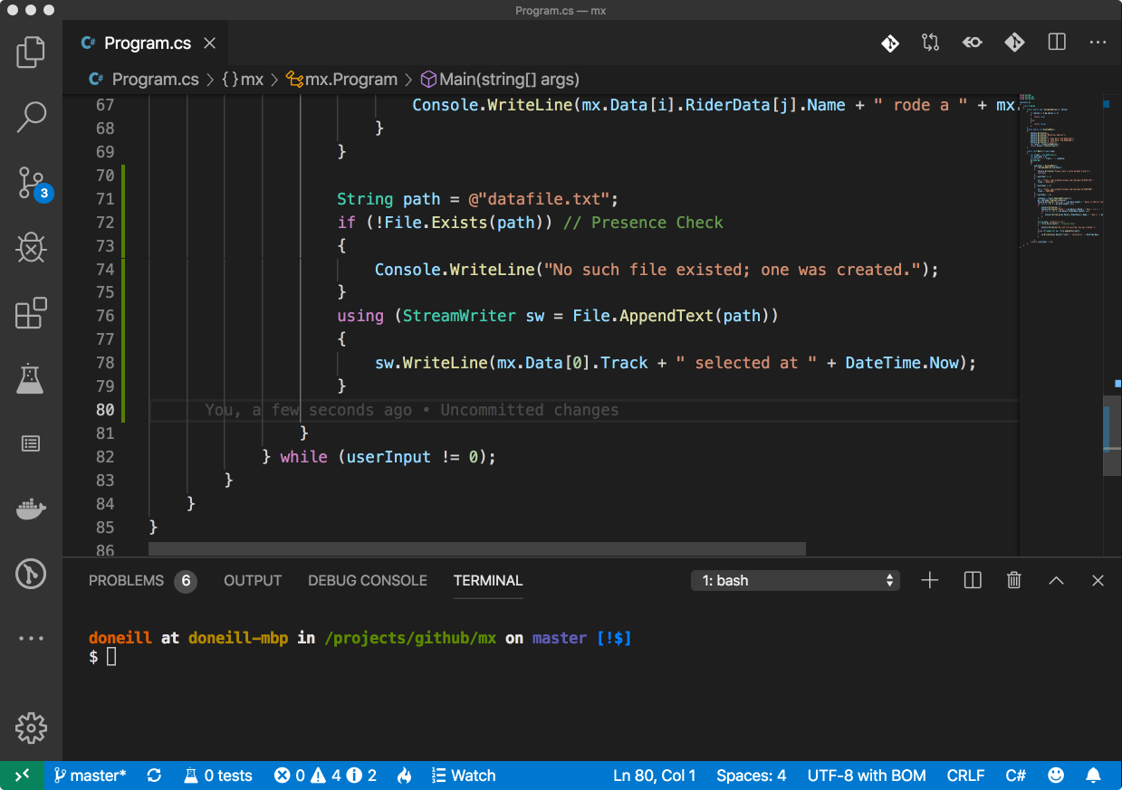
Notes:
Note you will need to import the System.IO library for the File type.

Slide 60
thanks

